Slide 1

CardioAI – Intelligent Heart Disease Risk Prediction System
Under the Esteemed Guidance of
Dr. V. Shanmukha Rao
Submitted by
P.Sravan Kumar
SK. Rehan
B.Tharun Raj
T.Teja
22KT1A4353
22KT1A4355
23KT5A4303
23KT5A4307

Slide 2
CONTENTS
1.Introduction
1.1Brief overview of the Project
1.1.1Scope
1.1.2Purpose
1.1.3Objective of the Study
1.1.4Literature Survey
1.2Problem Statement
1.3Proposed System
2.System Analysis
2.1System Study
2.1.1Feasibility Study
2.2Requirement Analysis
2.2.1Functional Requirements
2.2.2Non- Functional Requirements
2.3System Requirement Specification
2.3.1Hardware Requirements
2.3.2Software Requirements
2.3.3Libraries Requirements

Slide 3
Introduction
Cardiovascular diseases are among the leading causes of mortality worldwide, necessitating early detection and preventive care.
CardioAI is an intelligent healthcare platform designed to predict heart disease risk using machine learning techniques.
The system employs a Random Forest classification model trained on real-world clinical datasets to accurately assess patient risk levels. A secure, web-based dashboard allows users to input physiological parameters, upload medical reports, and receive real-time diagnostic insights along with personalized clinical, dietary, and lifestyle recommendations. By combining predictive analytics, data security mechanisms, and population health monitoring, CardioAI aims to support both healthcare professionals and individuals in proactive heart health management.

Slide 4
Abstract
Heart disease is one of the leading causes of mortality worldwide, making early and accurate diagnosis essential. This project presents an AI-based heart disease assessment system that predicts the risk of heart disease using machine learning techniques.
The system takes patient clinical parameters such as age, gender, blood pressure, cholesterol levels, heart rate, and other relevant attributes as input. The collected data is preprocessed to handle missing values, normalize features, and reduce noise. A Random Forest classifier is trained on a heart disease dataset to identify patterns associated with healthy and diseased conditions. By combining multiple decision trees, the model improves prediction accuracy and reduces overfitting. The prediction results are displayed through a user-friendly interface, assisting healthcare professionals and users in informed decision-making. The proposed system supports early diagnosis, enhances efficiency, and serves as a reliable decision-support tool for academic and healthcare applications.

Slide 5
Brief Overview of the Project
CardioAI is a full-stack healthcare analytics platform that leverages machine learning to assist in early-stage cardiovascular disease prediction.
Key Highlights:
AI-driven heart disease risk assessment
Real-time predictions using clinical parameters
Secure and interactive web dashboard
Personalized health recommendations
The system bridges the gap between traditional diagnostics and modern AI-powered healthcare solutions.

Slide 6
Scope
• Analyzes patient medical data to assess the risk of heart disease • Utilizes the Random Forest machine learning algorithm for accurate prediction • Supports multiple clinical parameters such as age, blood pressure, cholesterol, and heart rate • Provides early risk assessment to assist doctors and healthcare professionals • Reduces manual diagnosis effort through automated prediction • Can be deployed as a web-based application for easy accessibility • Suitable for academic research and preliminary clinical decision support

Slide 7
Purpose
The purpose of this project is to develop an AI-based system for early assessment of heart disease risk using machine learning techniques.
By applying the Random Forest algorithm to patient medical data, the system aims to provide accurate, reliable, and timely predictions, helping reduce manual diagnostic effort and supporting informed clinical decision-making.

Slide 8
Objective of the Study
• To design and develop an automated meeting summarization system • To convert speech data into accurate textual transcripts using deep learning models • To generate meaningful abstractive summaries from meeting content • To extract key points, action items, decisions, and deadlines • To deploy the system as a user-friendly web-based application

Slide 9
AUTHOR | TITLE | ALGORITHM | METHODOLOGY | DATASET | ACCURACY
Cleveland et al. | Heart Disease Prediction Using Logistic Regression on UCI Dataset | Logistic Regression | Used the UCI Heart Disease dataset with basic clinical attributes. Logistic Regression was applied after preprocessing to classify patients as healthy or diseased. | UCI Heart Dataset | ~77%
Patel et al. | Support Vector Machine–Based Heart Disease Risk Assessment Using Clinical Records | SVM | Clinical patient records were normalized and analyzed using Support Vector Machine (SVM) to separate heart disease risk classes. | Clinical Records | 81%
Kumar et al. | Decision Tree Model for Heart Disease Diagnosis Using Hospital Data | Decision Trees | Hospital data was processed and classified using Decision Tree algorithms, generating rule-based decisions for heart disease prediction. | Hospital Data | 83%
Sharma et al. | Neural Network–Based Heart Disease Prediction Using ECG and Clinical Features | Neural Networks | ECG signals combined with clinical features were trained using a Neural Network model to learn complex patterns for heart disease prediction. | ECG + Clinical | 85%

Slide 10
AUTHOR | TITLE | ALGORITHM | METHODOLOGY | DATASET | ACCURACY
Jaswanth Narayana et al. | HEART DISEASE PREDICTION SYSTEM USING MACHINE LEARNING | KNN | It begins with data analysis, including checking skewness via distribution plots for attributes like age, sex, and chest pain to understand data asymmetry. | Public Health Dataset | 84.86%
Ahmad Shaket al. | Machine learning models for prediction of co-occurrence of diabetes and cardiovascular diseases: a retrospective cohort study | Logistic Regression | This study used a retrospective cohort design with secondary analysis of DiScRi screening data from a rural health centre in New South Wales, Australia.​ Adults aged 40 years and above who volunteered for health checks were enrolled. | UCI Heart Disease | 94%
Adarsh Sharma et al. | Heart Disease Prediction: A Comparative Analysis of Machine Learning Algorithms | Random Forest | Public heart-disease datasets were collected and cleaned; missing numerical values were imputed (e.g., mean), categorical values imputed (e.g., chi -square–based strategies), and features normalized or scaled. | Heart Dataset | 84.96%
Ch. Anwar et al. | Effectively Predicting the Presence of Coronary Heart Disease Using Machine Learning Classiﬁers | GBA, MLP | The study aims to predict the presence of coronary heart disease using multiple machine learning classifiers applied to the UCI Heart Disease dataset. | UCI Heart Disease | 95%

Slide 11
Problem Statement
Heart disease remains one of the leading causes of death worldwide, and early detection is critical for effective treatment and prevention.
Traditional diagnosis methods often rely on manual analysis of medical data, which can be time-consuming and may not always provide accurate risk assessment.
Existing automated systems may lack reliability or require complex and expensive infrastructure. Therefore, there is a need for an accurate, efficient, and cost-effective AI-based system that can analyze patient health parameters and predict the risk of heart disease at an early stage.

Slide 12
EXISTING SYSTEMS
Before the development of AI-based heart disease prediction platforms, heart disease diagnosis and risk assessment relied on the following existing systems:
1. Rule-Based Expert Systems
Some hospitals use computer-based decision support systems that follow predefined rules, such as:
IF cholesterol > X AND blood pressure > Y → high risk
IF age > 50 → moderate risk
These systems depend heavily on fixed thresholds defined by medical experts.
2.. Single Machine Learning Model Systems
Earlier research and implementations used basic machine learning algorithms such as:
Logistic Regression
Naive Bayes
These models are trained on limited datasets and often used individually without ensemble techniques.

Slide 13
Disadvantages of existing systems
1. Time-Consuming Diagnosis
Manual analysis of medical reports takes significant time.
Early detection is delayed due to dependence on multiple tests and appointments.
2. Human Error and Subjectivity
Diagnosis depends on the doctor’s experience.
Different doctors may give different opinions for the same patient data.
3. Limited Accuracy
Rule-based systems cannot adapt to new patterns in data.
Single machine learning models often suffer from overfitting or underfitting.

Slide 14
Proposed System
The proposed system is an AI-based heart disease assessment platform designed to predict the risk of heart disease using machine learning techniques. The system takes patient medical parameters such as age, gender, blood pressure, cholesterol levels, heart rate, and other relevant clinical attributes as input.
The collected data is preprocessed to handle missing values, normalize features, and remove noise. A Random Forest classifier is then trained on a heart disease dataset to learn patterns associated with healthy and diseased conditions. Random Forest combines multiple decision trees to improve prediction accuracy and reduce overfitting.
Once trained, the model predicts whether a patient is at risk of heart disease. The prediction results are displayed through a user-friendly interface, enabling healthcare professionals or users to make informed decisions. This system supports early diagnosis, improves efficiency, and serves as a reliable decision-support tool for both academic and healthcare applications.

Slide 15
Advantages Of Proposed System
1. High Prediction Accuracy
The system uses a Random Forest classifier, which combines multiple decision trees.
This ensemble approach improves accuracy and minimizes overfitting compared to single models.
2. Early Detection of Heart Disease
Predicts heart disease risk before severe symptoms appear.
Supports preventive healthcare and timely medical intervention.
3. Automated and Fast Assessment
Automatically analyzes patient data and produces results within seconds.
Reduces dependency on manual diagnosis and saves time for healthcare professionals.

Slide 16
Advantages Of Proposed System
4. Reduced Human Error
Eliminates subjectivity involved in manual diagnosis.
Provides consistent and reliable predictions based on data patterns.
5. Handles Complex Medical Data
Efficiently processes multiple clinical attributes such as age, blood pressure, cholesterol, and heart rate.
Captures hidden relationships between features that traditional systems cannot detect.

Slide 17
Why Random Forest Is Chosen
Random Forest is selected for the AI Heart Disease Assessment project because of the following advantages:
High Accuracy :Combines multiple decision trees, which improves prediction accuracy compared to a single model.
Handles Non-Linear Data: Medical data is often complex and non-linear. Random Forest captures these patterns effectively.
Reduces Overfitting : By averaging results from many trees, it avoids overfitting common in individual decision trees.
Works Well with Medical Datasets : Performs efficiently even with missing values and mixed data types (numerical + categorical).
Feature Importance: Helps identify important health parameters such as cholesterol, blood pressure, and age.
Robust and Reliable: Suitable for real-world healthcare applications where consistency is crucial.

Slide 18
System Analysis
System Study
The system study focuses on understanding the overall workflow and functioning of the AI-based heart disease assessment system. It examines how patient medical data is collected, processed, and analyzed to predict the risk of heart disease.
The system begins with data input, where patient health parameters such as age, gender, blood pressure, cholesterol levels, and heart rate are provided. The data is then preprocessed to handle missing values, normalize features, and remove inconsistencies. After preprocessing, the data is passed to the Random Forest model, which analyzes the patterns learned during training to generate a prediction.
The output of the system indicates whether the patient is at risk of heart disease or not, and the result is displayed through a user-friendly interface. The study ensures that the system is accurate, efficient, and scalable, making it suitable for real-time health assessment and academic research.

Slide 19
Feasibility Study
The feasibility study evaluates whether the proposed AI-based Heart Disease Assessment System can be developed and implemented successfully.
1. Technical Feasibility
The system is technically feasible as it uses well-established machine learning techniques, specifically the Random Forest algorithm. Required tools such as Python, machine learning libraries (NumPy, Pandas, Scikit-learn), and deployment frameworks are readily available and widely supported. The model can be trained and executed on standard computing systems without specialized hardware.
2. Economic Feasibility
The proposed system is cost-effective because it relies on open-source tools and datasets, such as the UCI Heart Disease dataset. No expensive software licenses or hardware are required, making it affordable for academic institutions and small healthcare setups.
3. Operational Feasibility
The system is easy to use and requires minimal training. Users only need to enter patient health parameters to obtain predictions. The simple interface and automated prediction process ensure smooth operation and quick adoption by healthcare professionals or users.

Slide 20
Requirement Analysis
Functional Requirements
The system shall allow users to enter patient medical details such as age, gender, blood pressure, cholesterol level, and heart rate
• The system shall validate input data to ensure correctness and completeness
• The system shall preprocess the medical data by handling missing values and normalizing features
• The system shall apply the Random Forest algorithm to analyze patient data
• The system shall predict the risk of heart disease based on the trained model
• The system shall display prediction results clearly to the user
• The system shall support multiple predictions for different patients

Slide 21
Non-Functional Requirements
• The system shall provide high prediction accuracy for reliable heart disease risk assessment • The system shall ensure fast response time for quick result generation • The system shall be scalable to handle multiple users and large datasets • The system shall ensure data security and privacy of patient medical information • The system shall be reliable and robust, producing consistent results • The system shall have a user-friendly interface for easy operation • The system shall be maintainable and extensible for future enhancements

Slide 22
System Requirement Specification
Hardware Requirements
Software Requirements
Processor: Intel i5 or higher
RAM: Minimum 8 GB
Storage: Minimum 50 GB
Operating System: Windows
Programming Language: Python3.9,Kotlin
Backend Framework: Flask / FastAPI
Frontend: HTML, CSS, JavaScript
Android Studio (Latest stable version)
Android SDK

Slide 23
Library Requirements
• NumPy – For numerical computations and array operations
• Pandas – For data manipulation, cleaning, and analysis
• Scikit-learn – For implementing the Random Forest algorithm, preprocessing, and model evaluation
• Matplotlib – For data visualization and performance analysis
• Seaborn – For advanced statistical visualizations (optional)
• Flask / Streamlit – For building a user-friendly web interface (if deployed as a web application)

Slide 24
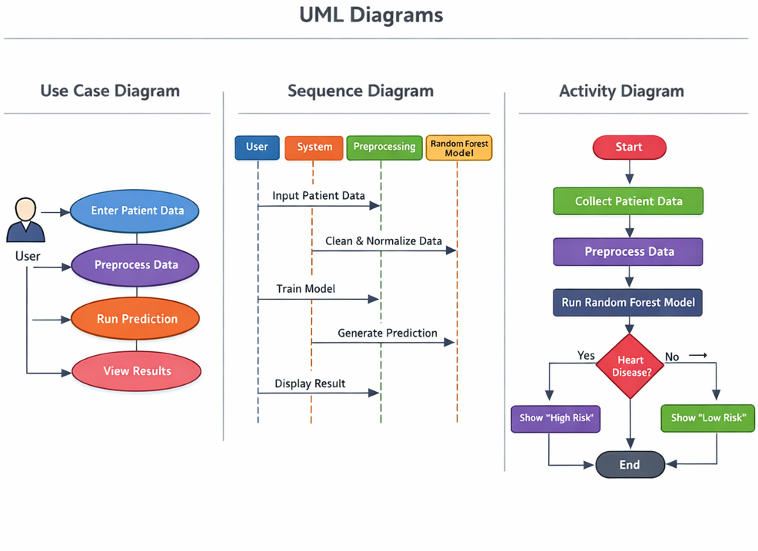
UML Diagrams

Slide 25
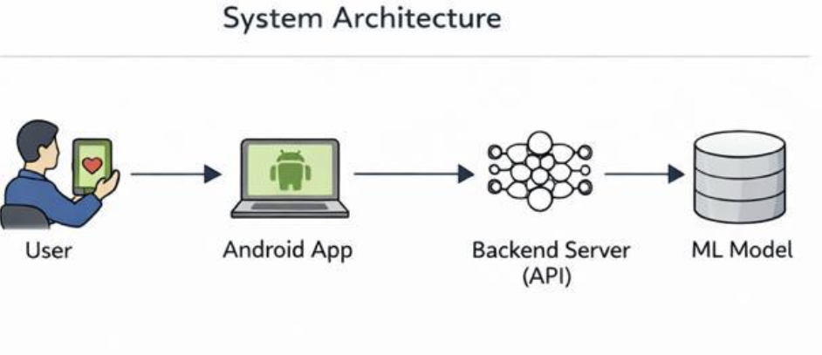
SYSTEM ARCHITECTURE

Slide 26
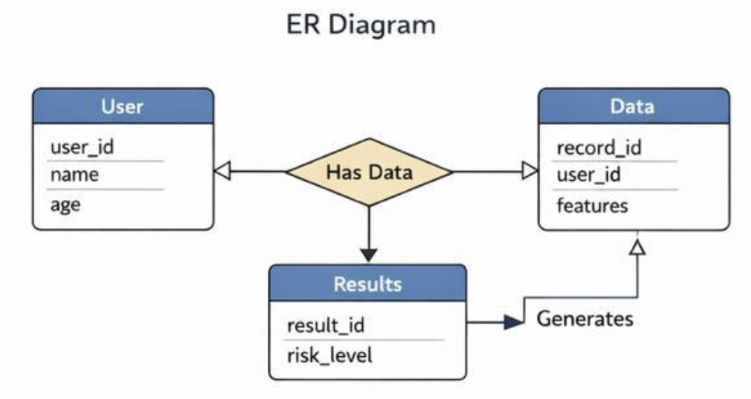
ER DIAGRAM

Slide 27
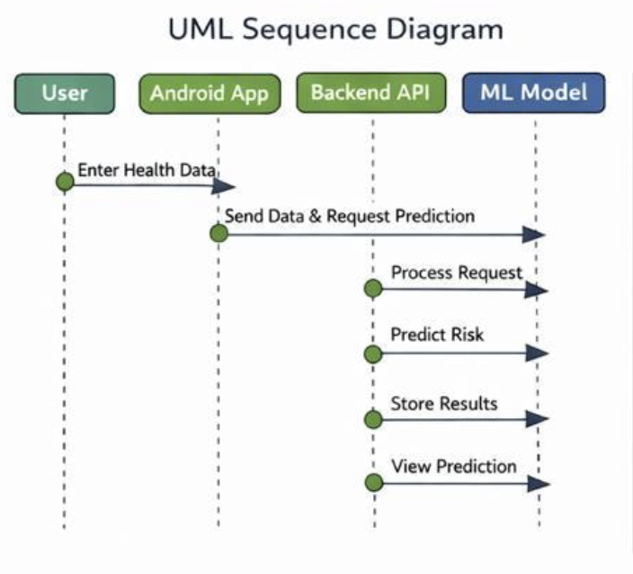
SEQUENCE DIAGRAM

Slide 28
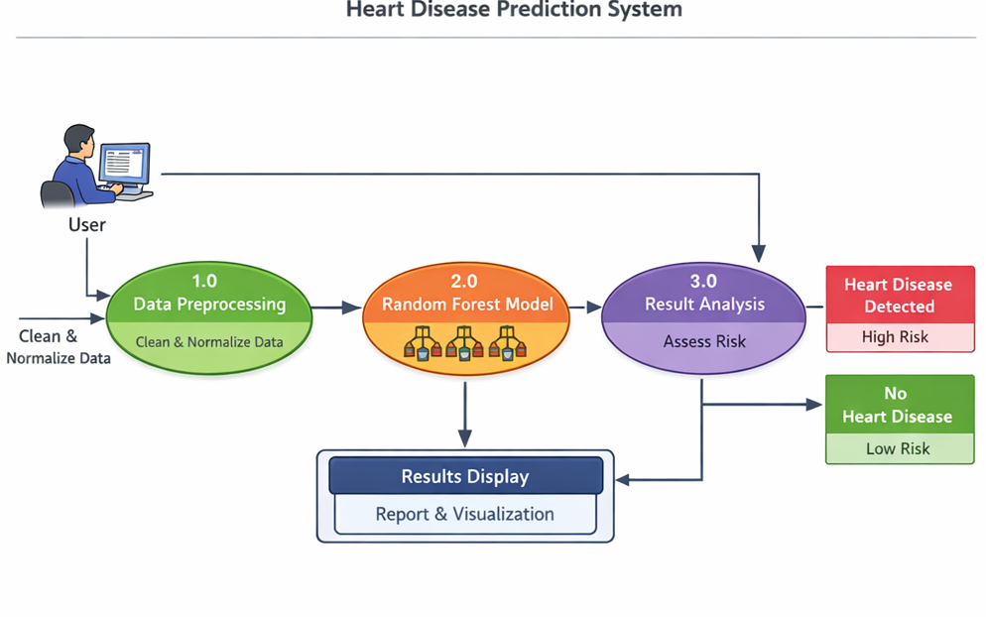
Data Flow Diagram

Slide 29
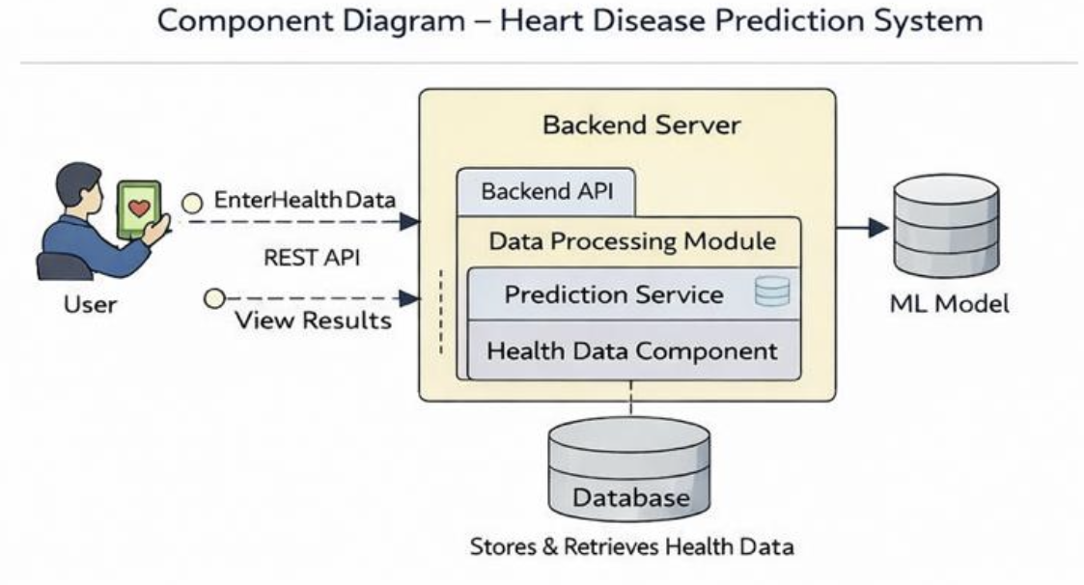
COMPONENT DIAGRAM

Slide 30
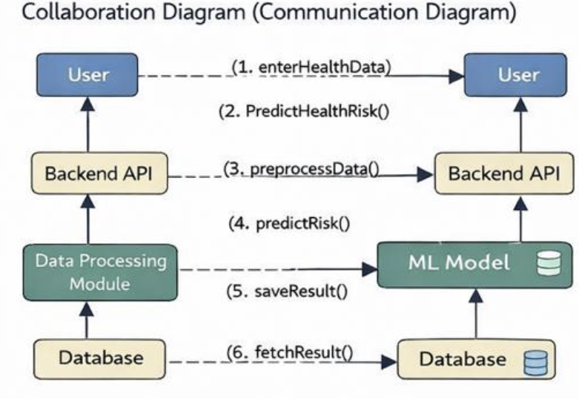
COLLABORATION DIAGRAM

Slide 31
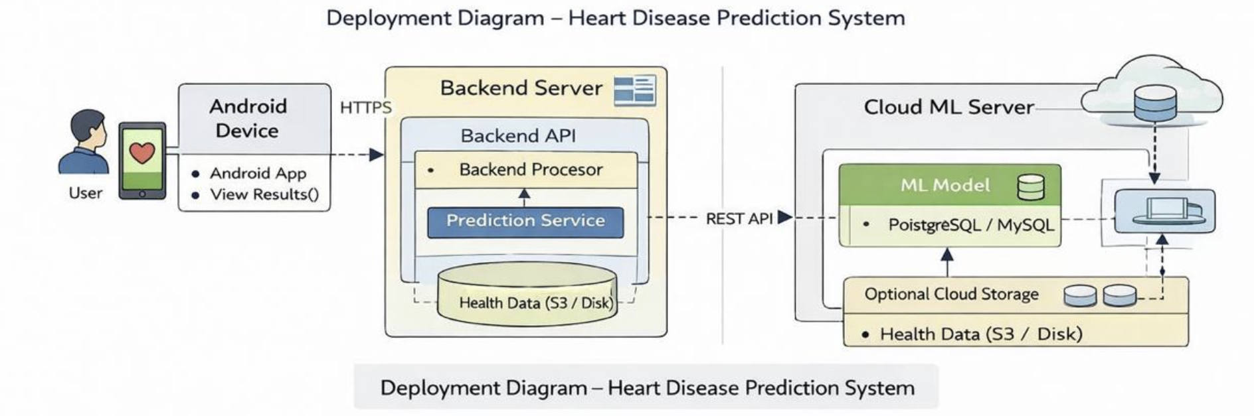
DEPLOYMENT DIAGRAM

Slide 32
REFERENCES
D. W. Hosmer, S. Lemeshow, and R. X. Sturdivant, Applied Logistic Regression, 3rd Edition, Wiley, 2013.
L. Breiman, Random Forests, Machine Learning, 45(1):5–32, 2001.
UCI Machine Learning Repository, Heart Disease Dataset, https://archive.ics.uci.edu/ml/datasets/heart+disease
Pedregosa et al., Scikit-learn: Machine Learning in Python, Journal of Machine Learning Research, 2011.
Python Documentation, https://www.python.org/doc/
Matplotlib & Seaborn Documentation, https://matplotlib.org

Slide 33
STATUS OF WORK
The status of work describes the current progress of the project.
Literature survey and problem analysis – Completed
Dataset collection (UCI Heart Disease Dataset) – Completed
Data preprocessing – Completed
Random Forest model implementation – Completed
Model training and testing – In progress
User interface development – In progress
System testing and performance evaluation – Pending / In progress

Slide 34


